Slide 1
Stirling Engine Final Project
Josiah Farinacci and Cyrus Harris

Slide 2
Summary
Introduction
Design Objectives
Design Constraints
3D Print Car
Design Description
Calculations and Analysis
Demonstration
Comparison
Conclusions
Recommendations
Notes:
Cyrus

Slide 3

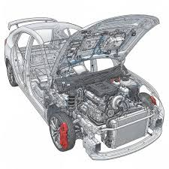
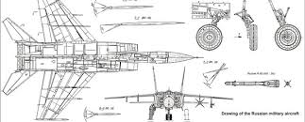
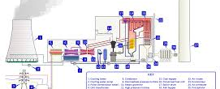
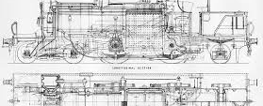
Introduction - heat engines
Characteristics
Heat source and sink
Come in many shapes, sizes, and applications
Examples
From cars to planes…
and power plants to trains…
The applications are endless
Notes:
Cyrus

Slide 4
Design Constraints
3D Print the car
One or two tea candles or an alcohol lamp
Alpha, Beta, or Gamma Stirling engine
No source of embedded energy
Flywheel must not possess kinetic or potential energy
Notes:
Josiah

Slide 5
Design objectives
Work
Convert heat into work or kinetic energy
Efficiency
Minimize work input and increase work output
Notes:
Josiah

Slide 6
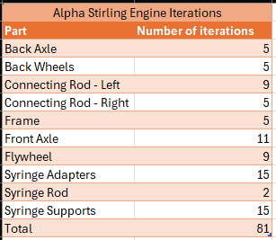
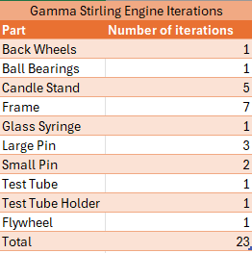
3D Print Car – Iterations
Notes:
Josiah
Combined total: 104

Slide 7
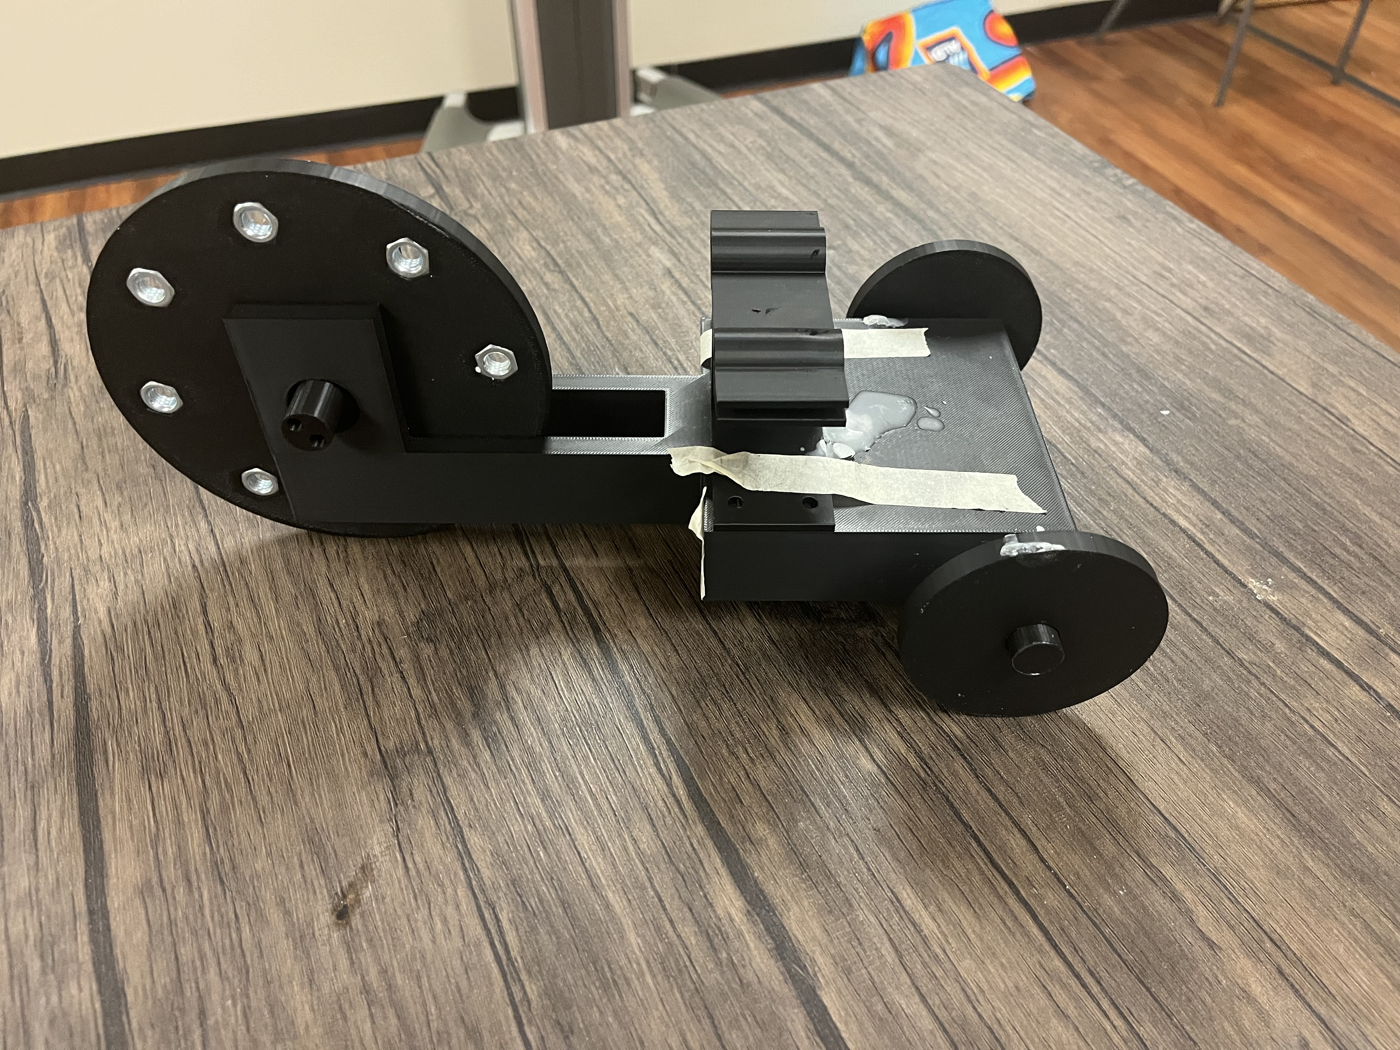

3D Print Car – Test 1
Notes:
Josiah

Slide 8
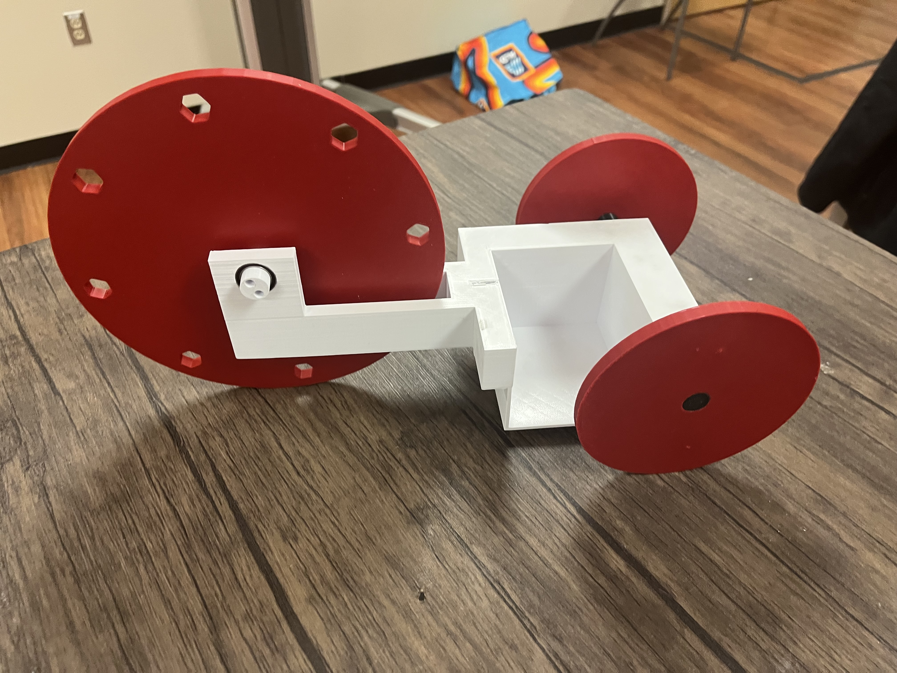
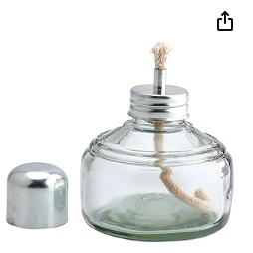
3D Print Car – Test 2

Slide 9
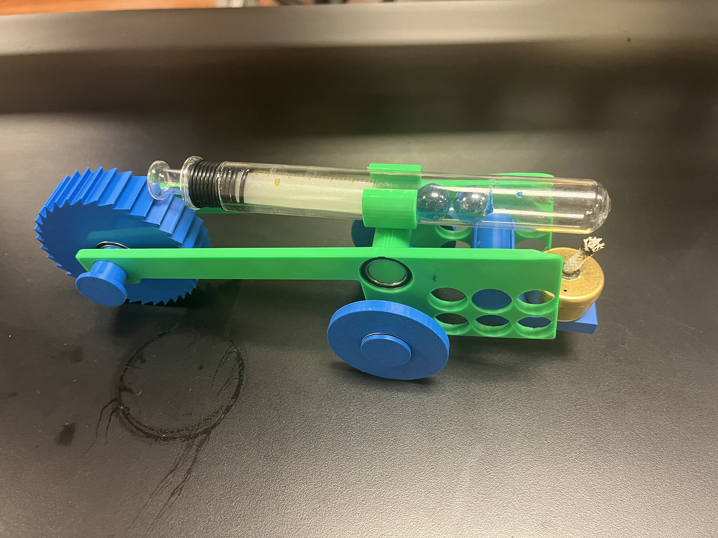
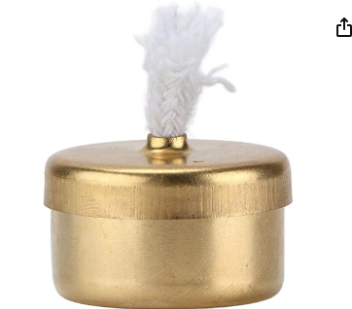
3D Print Car – Test 3
Notes:
Josiah

Slide 10
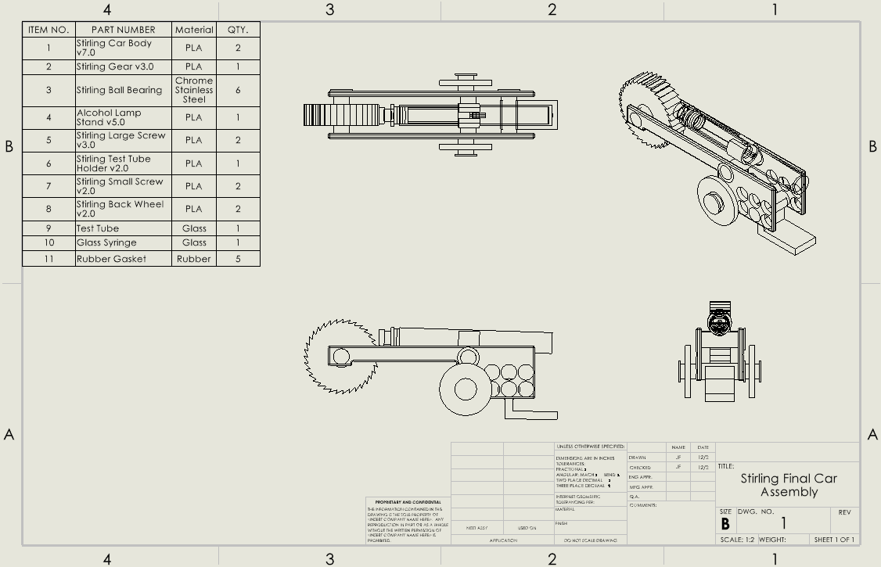
SOLIDWORKS – Stirling 3D Printed Car Engineering Drawing

Slide 11
Design Description
Light the candle
Candle heats syringe
Syringe expands
End of syringe pushes gear-like flywheel forward
Celebrate
Notes:
Josiah

Slide 12
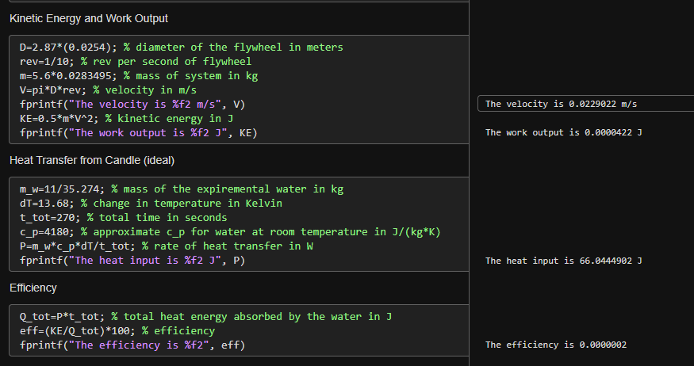

Calculations and Analysis
Notes:
Cyrus

Slide 13
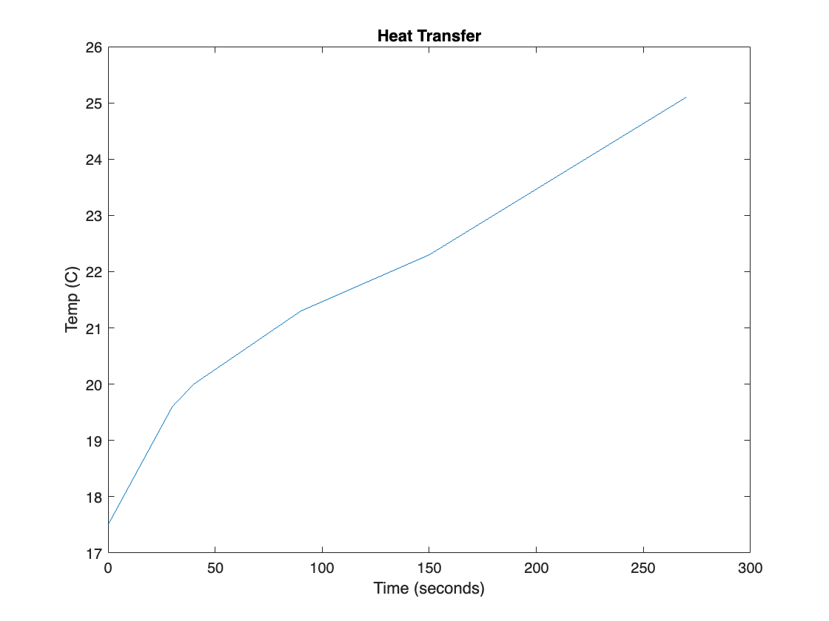
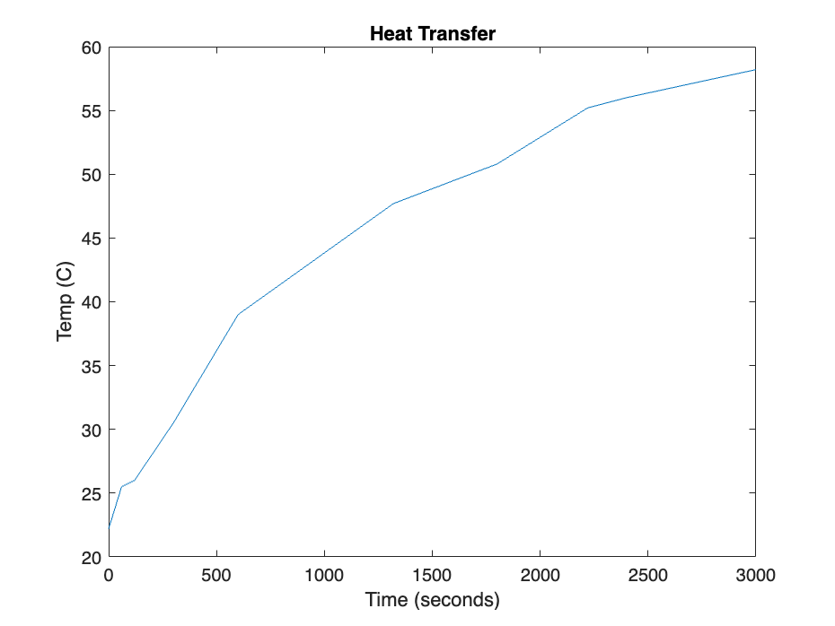
Heat Transfer Rates
Alcohol Lamp
Wax Candle
Notes:
Cyrus

Slide 14
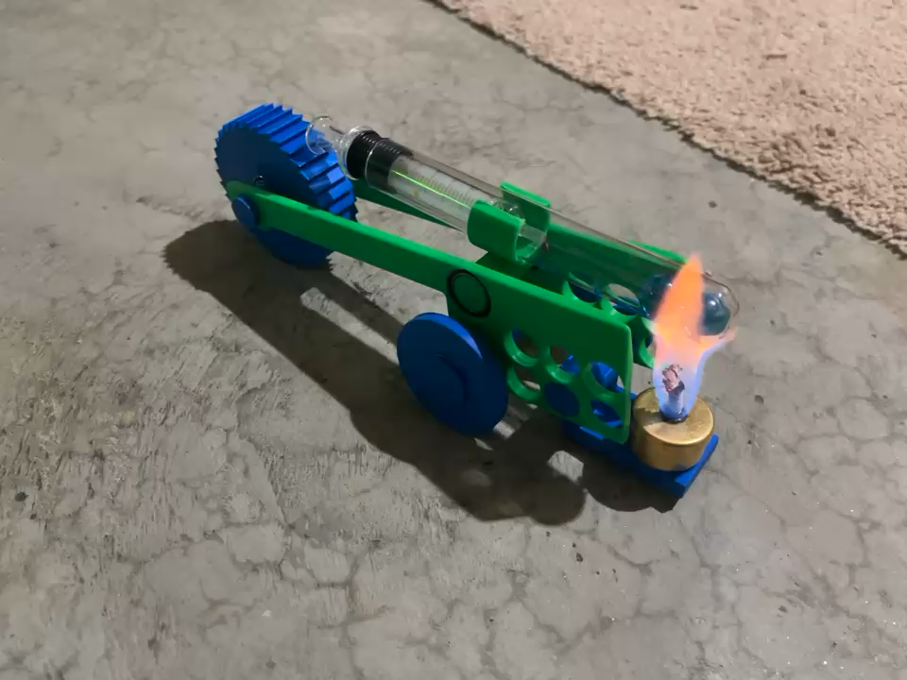
Demonstration
Notes:
Cyrus

Slide 15
Comparison - Alpha
Information:
Two pistons in separate cylinders
Pros:
High power density
Cons:
Hard manufacturability
Connected in series
High efficiency
Notes:
Josiah Only one cylinder for manufacturability

Slide 16
Comparison - Beta
Information:
One cylinder
Displacer piston
Power piston
Pros:
Medium manufacturability
Cons:
Medium power density
Medium efficiency
Notes:
Josiah Only one cylinder for manufacturability

Slide 17
Comparison - Gamma
Information:
One cylinder
Displacer piston
Power piston
Pros:
Easy manufacturability
Cons:
Low power density
Low efficiency
Notes:
Josiah Only one cylinder for manufacturability

Slide 18
Conclusions
Lessons learned
“Never give up…” - Josiah
Ensure the syringe has an airtight connection with the test tube
Start working on the project early
Looks and size are not everything (1 Samuel 16:7)
Hard work pays off (Proverbs 22:29)
Notes:
We started the project on October 14th
Cyrus

Slide 19
Recommendations
Optimize Beta Stirling engine
1
Improved flywheel design
Manufacture enclosure around candle
Optimize Alpha Stirling engine
2
Use smaller alcohol lamp
Try Gamma Stirling engine design
3
Compare efficiencies of new designs
4
Make connection points more accurate

Slide 20
Thank you!
Q/A
Notes:
Mass of car: 0.159 kg

Slide 21


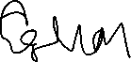


Team Contributions and Honor Code
 | Cyrus Harris | Josiah Farinacci
Hours | 25 | 36
Signature
I, Cyrus Harris and Josiah Farinacci, pledge to complete this schoolwork in a manner consistent with God’s Biblical mandate, demonstrating actions of integrity, and without resorting to cheating or plagiarism”.

